Slide 1
Welcome to the P&M Technical Session
Dr. Joshua Piehl Mechanical Engineer, US Army DEVCOM – GVSC
Thomas Trzaska Director, Strategic Technology, RENK America (Retired)
Porfirio Nogueiro Technical Fellow, BAE Systems
Isaac Rife Program Engineering Manager, BAE Systems
Dr. Eric Gingrich Specialist Research Engineer, US ARMY DEVCOM - GVSC

Slide 2

Published Paper Access
Use the link or scan the QR code below for access to today’s published papers.
- Papers can be found next in the agenda next to their respective session
Papers will be available through SAE in September.
https://www.ndia-mich.org/gvsets/agenda

Slide 3

GVSETS Technical Paper Archive
https://saemobilus.sae.org/
Search “ndia”

Slide 4
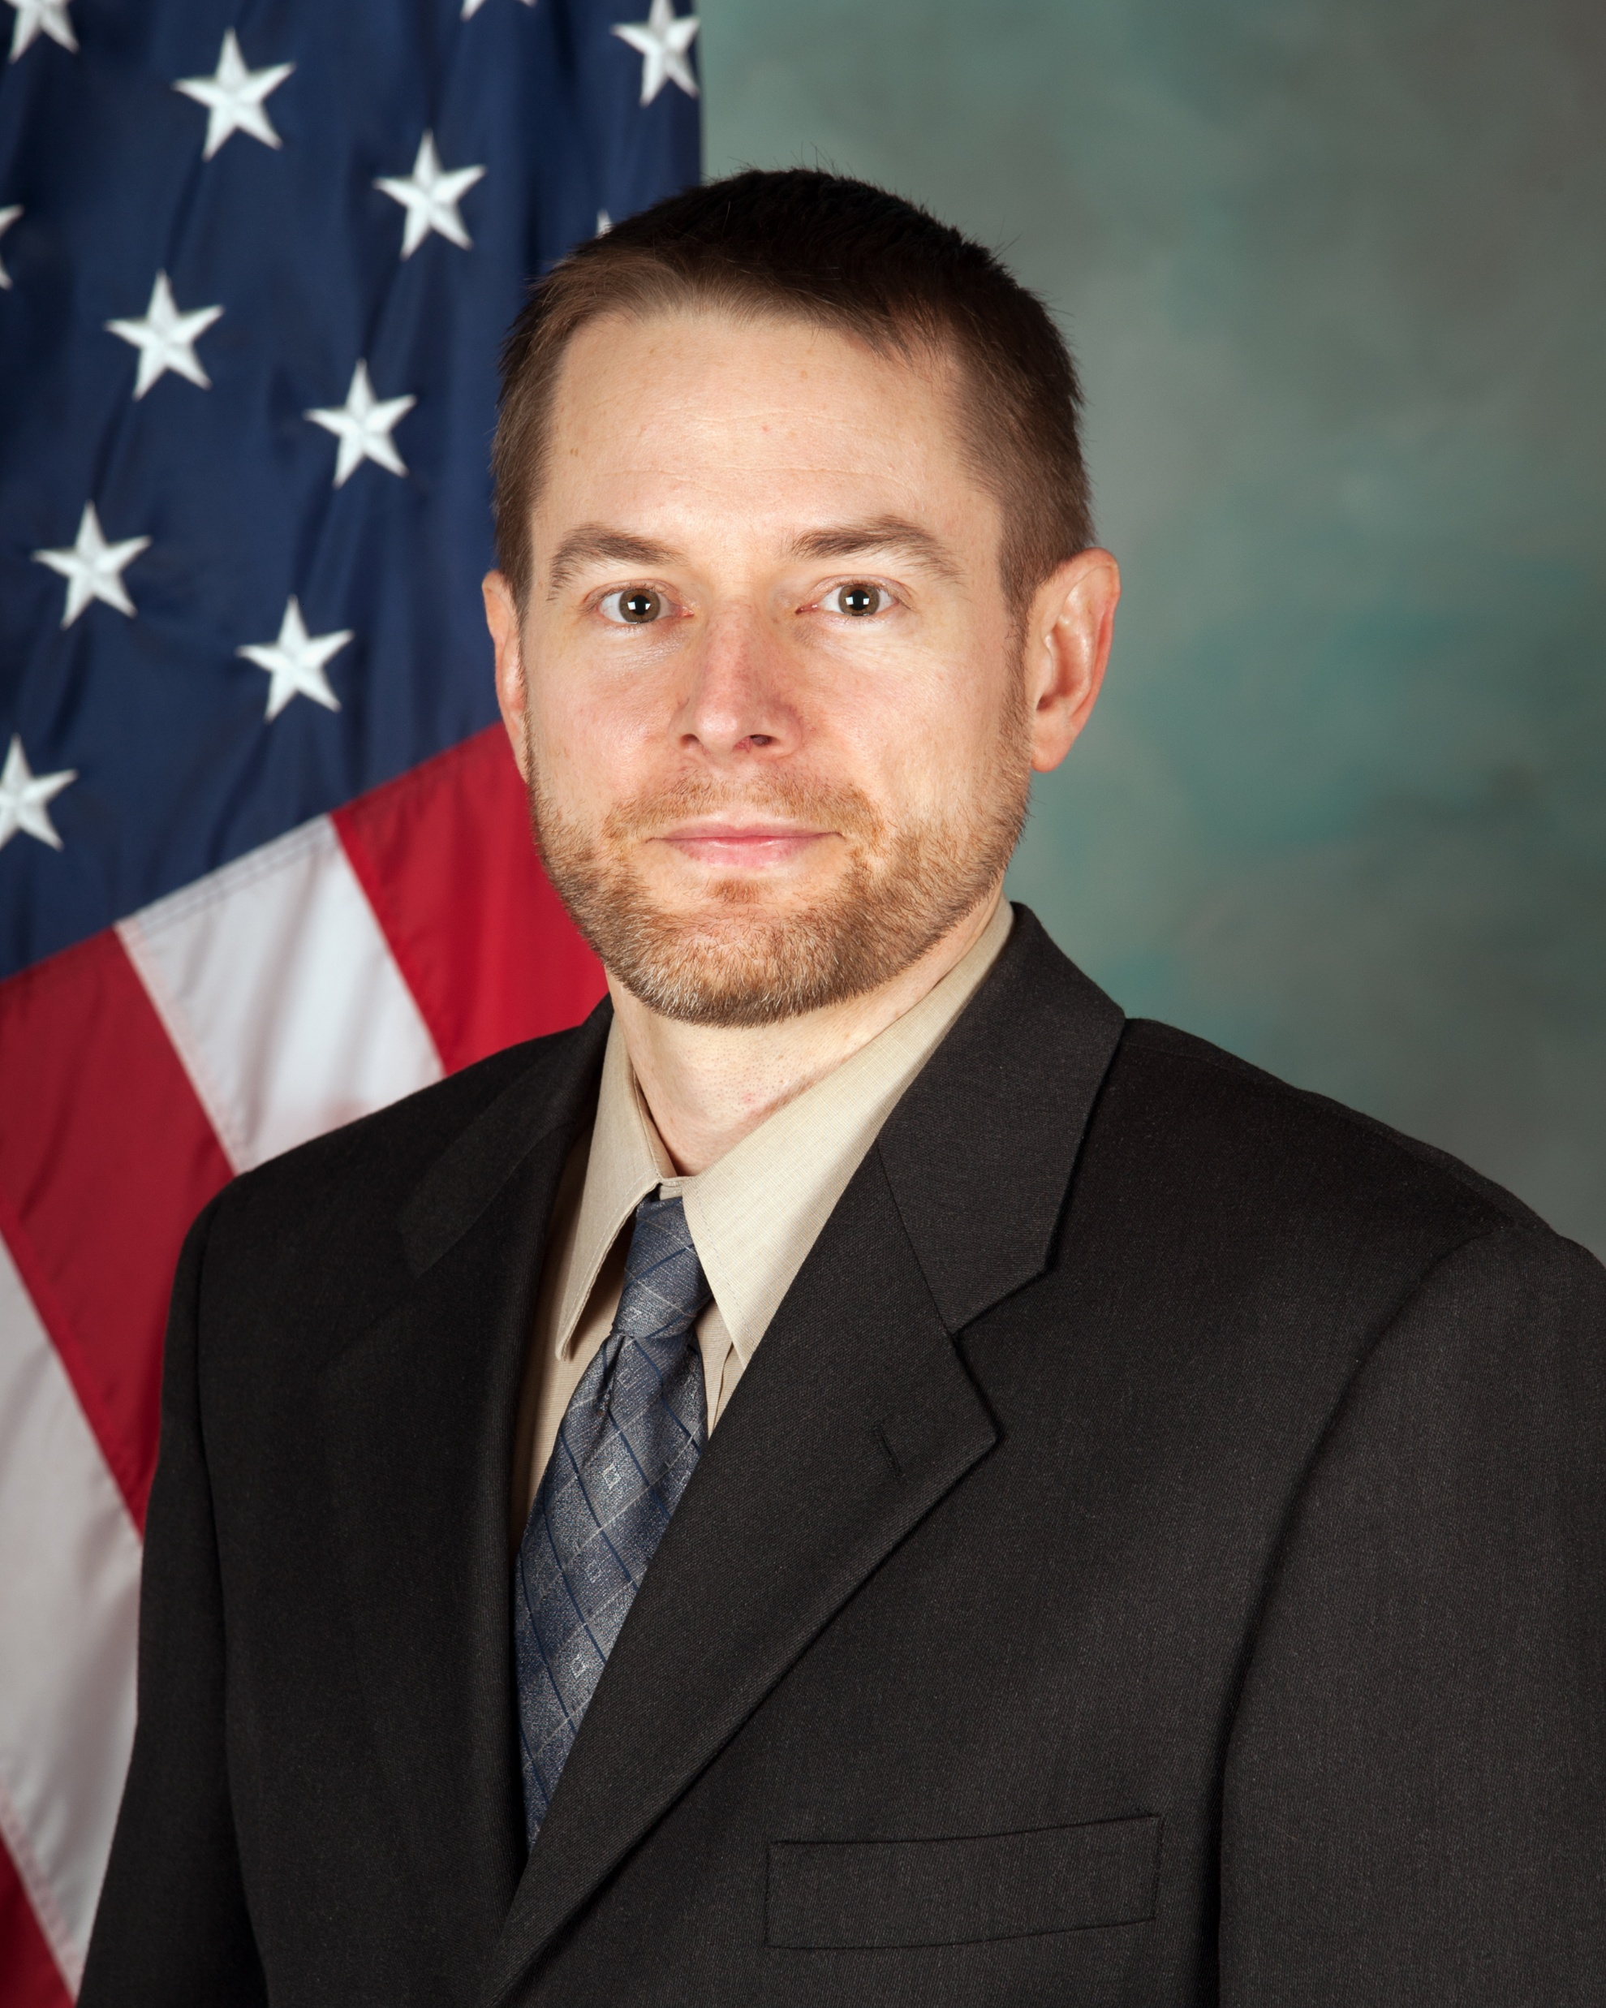
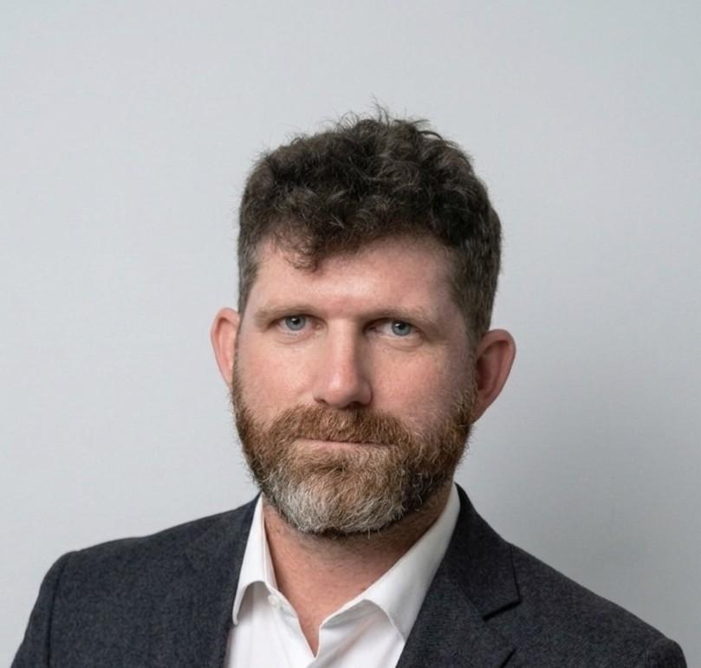
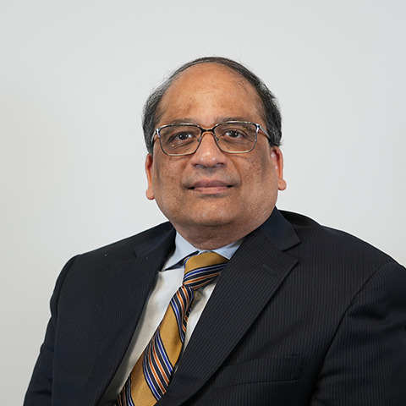
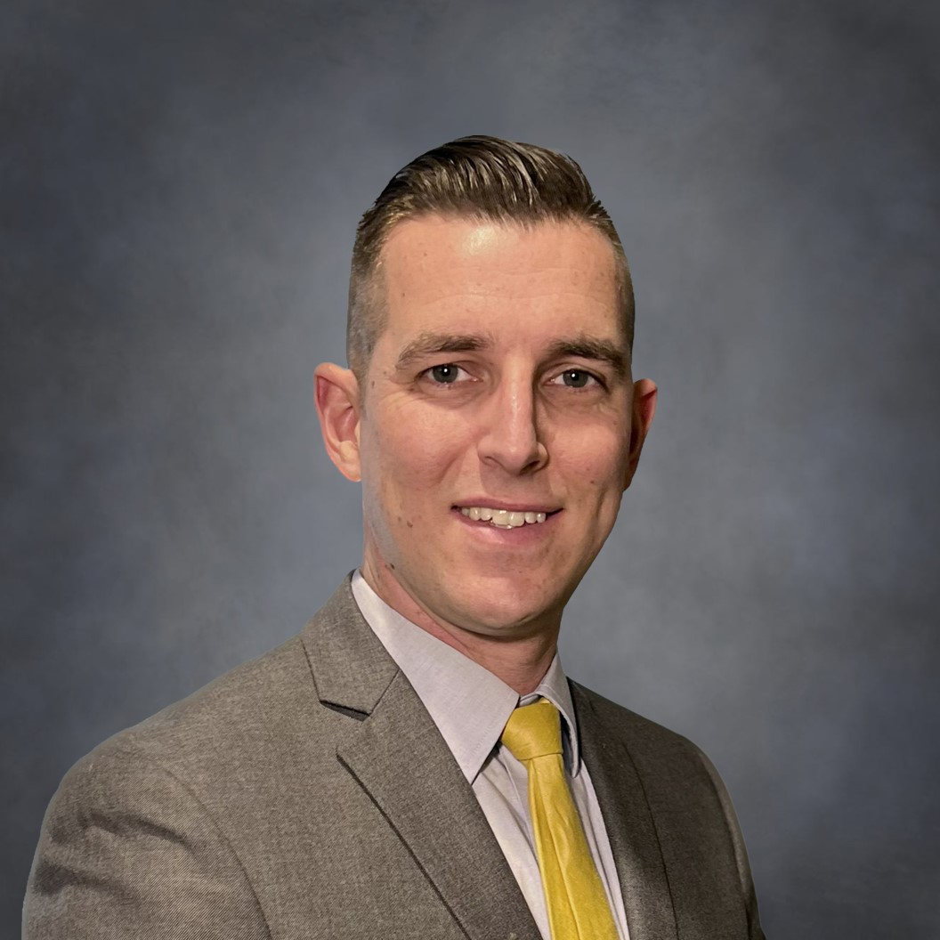
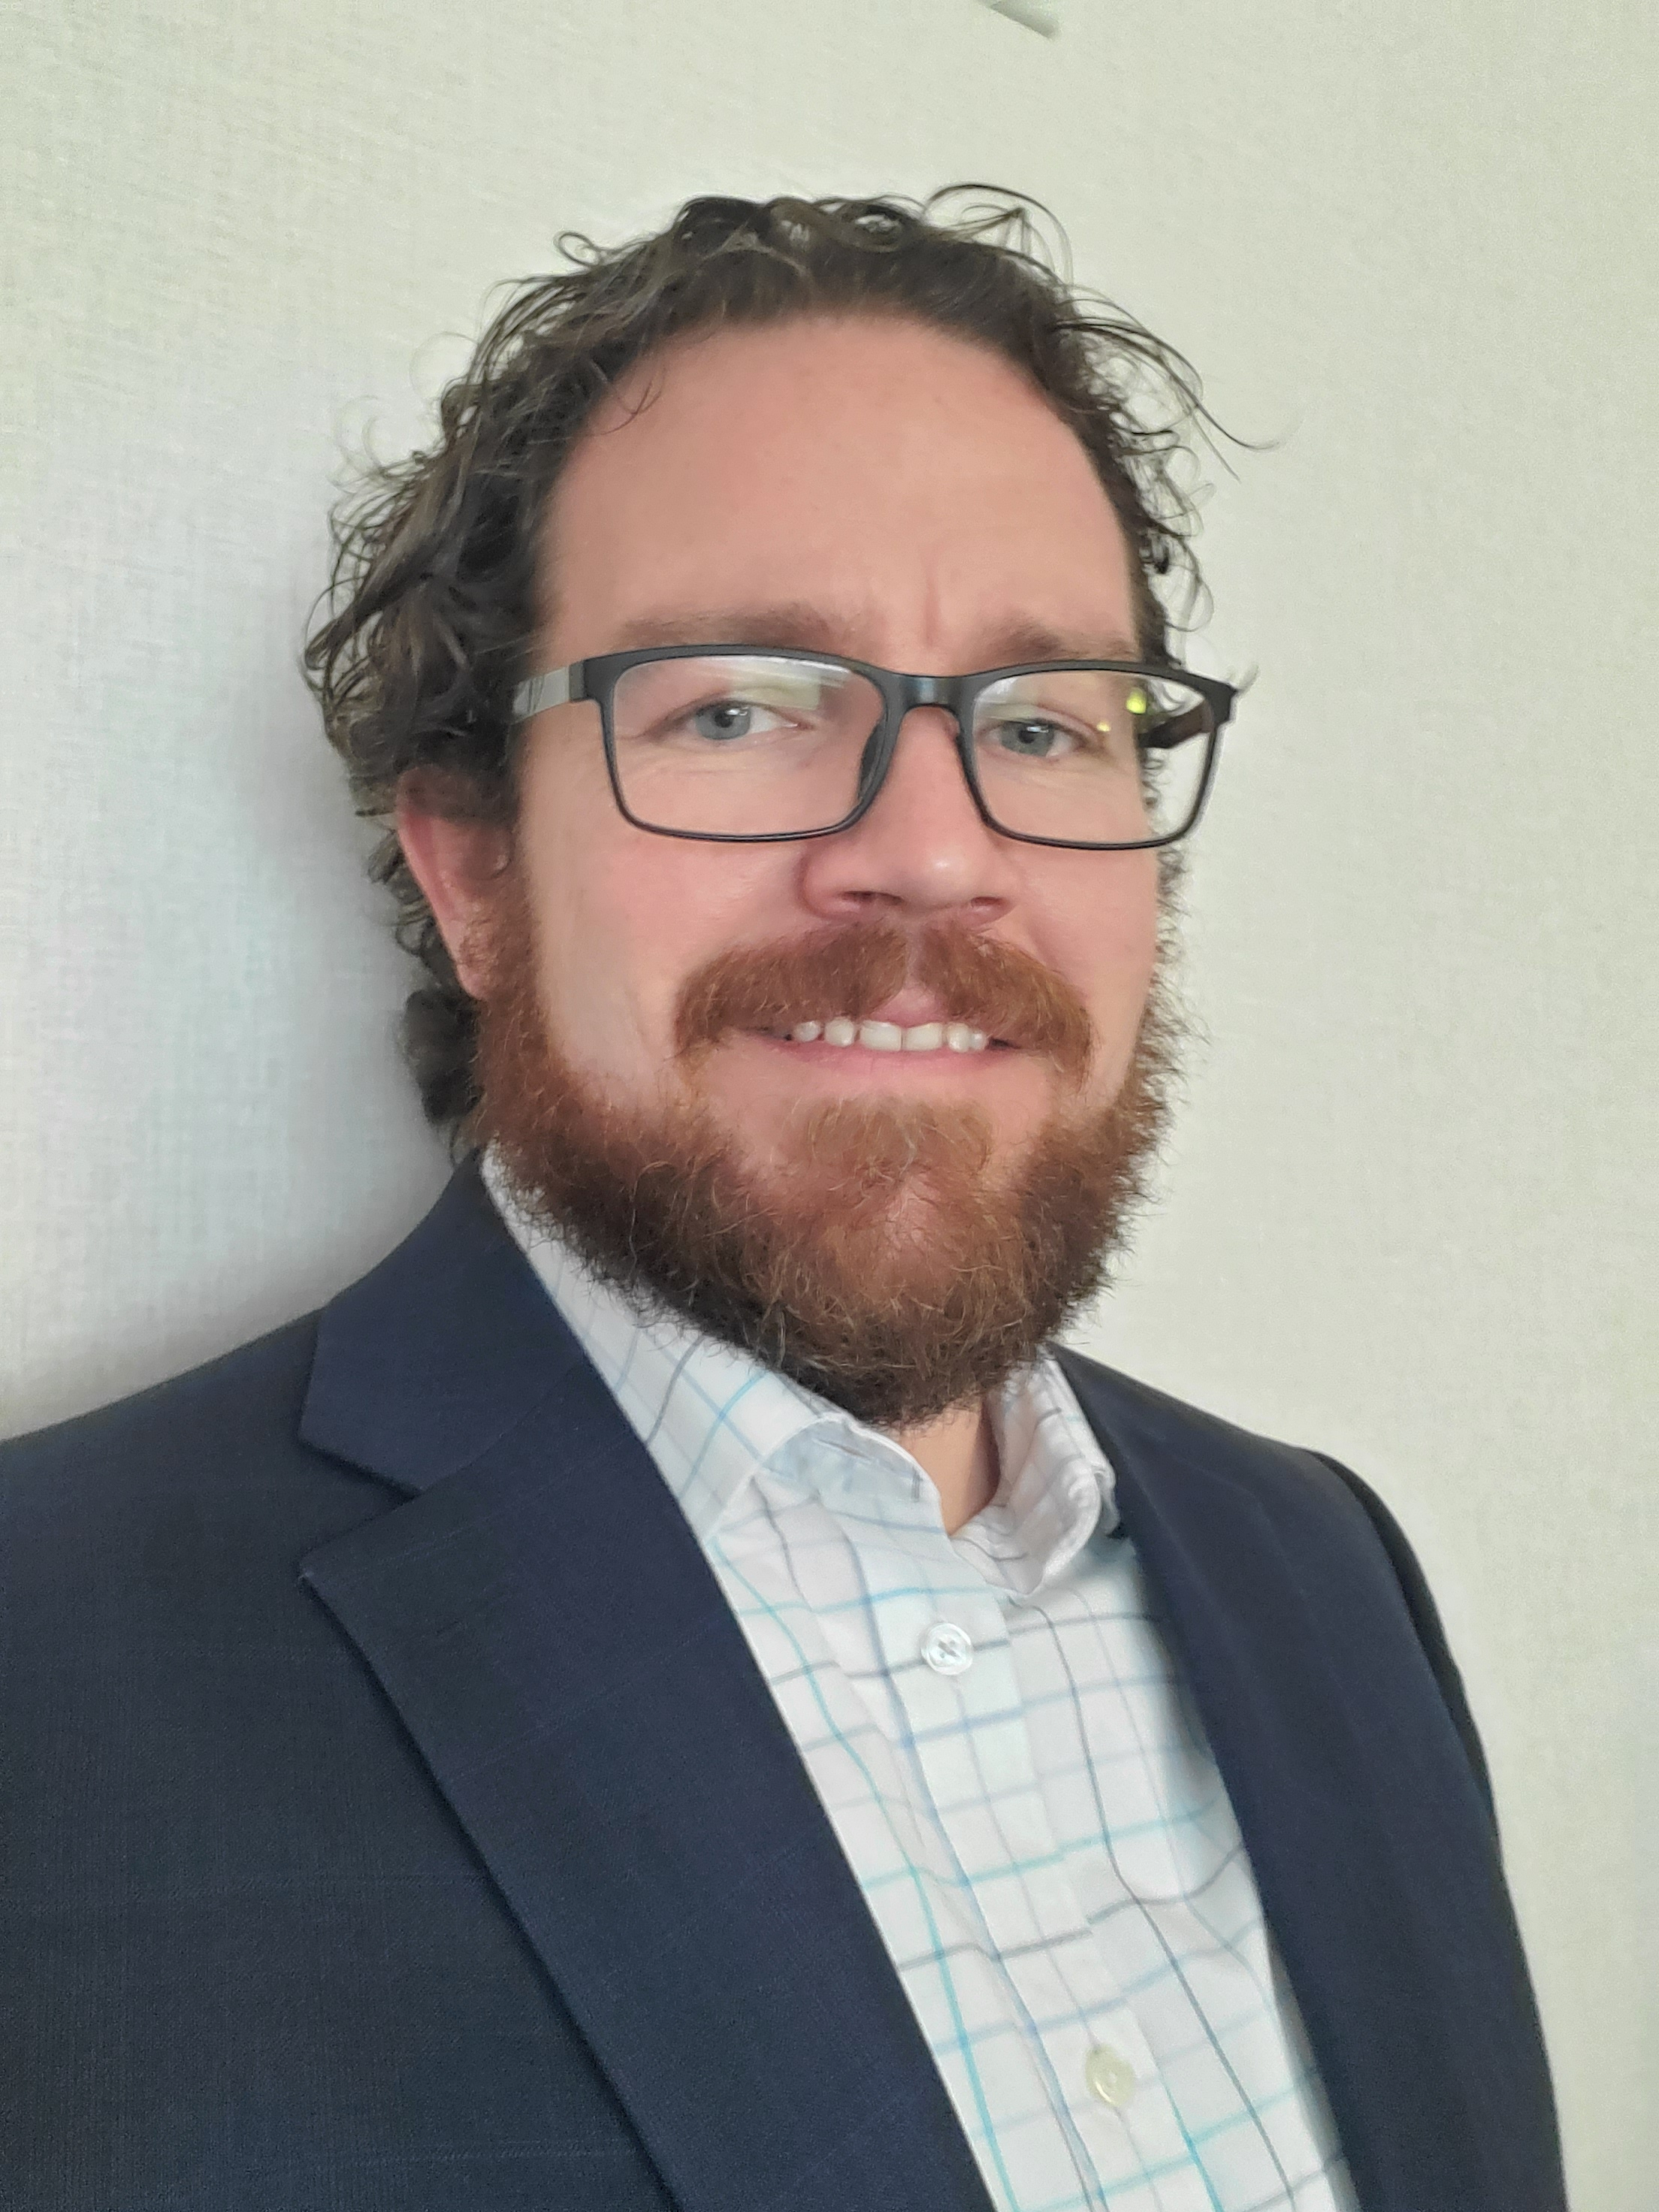
3:30 PM
Panel: Benefits and Challenges using Commercial off-the-shelf for Ground System Mobility
Moderator: David LaRoy – Technical Expert, US Army DEVCOM GVSC
Brody Ringler – Chief Engineer, MATBOCK LLC
Isaac Rife – Program Engineering Manager, BAE Systems
Ramprasad Krishnamachari – Power & Mobility – Principle Engineer, General Dynamics Land Systems
Mark Van Wingerden – Global Product Strategy Manager, EATON

Slide 5
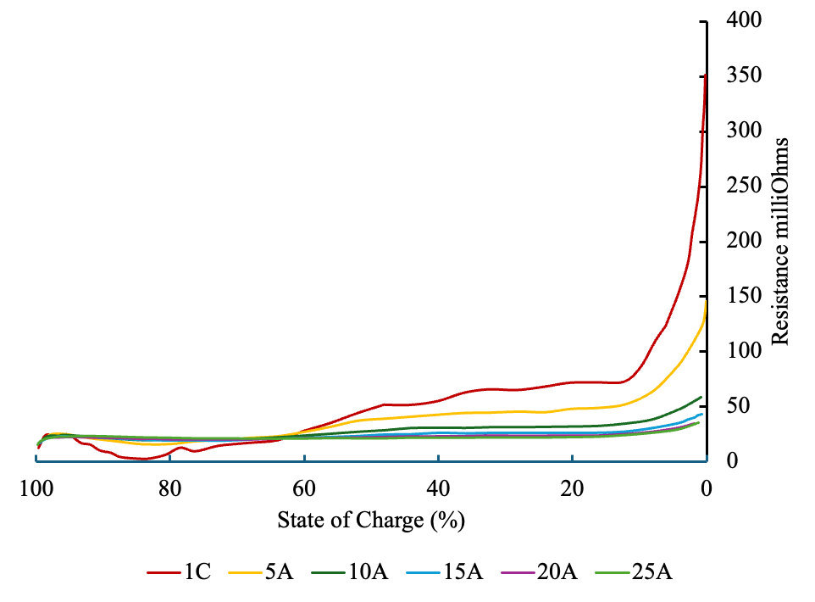
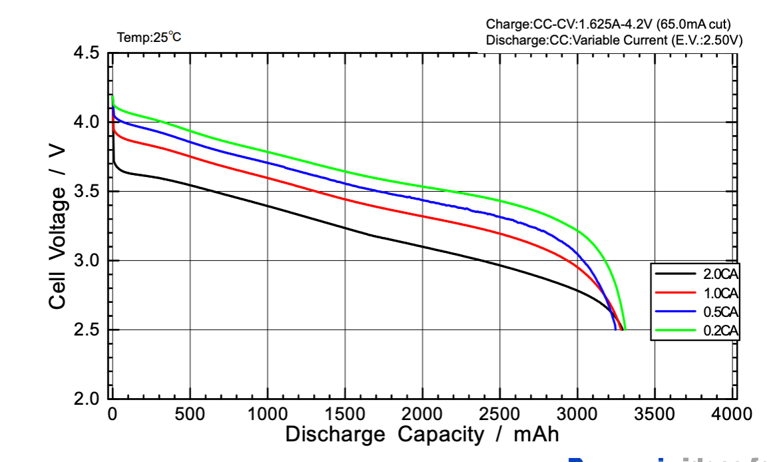
4:30 PM
Deriving Instantaneous Electro-Thermal Parameters and Heat Generation from Constant-Current Discharge Data
Dr. Nicholas Ingarra
Dr. Krzysztof Kobus
Jadon Kobus
Stable Operating Window

Slide 6
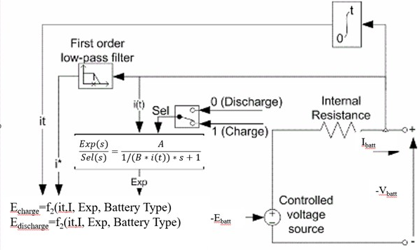
4:50 PM
Time-Dependent Power Flow Modeling for Non-Passive Load in Battery Electric Propulsion Architectures
Dr. Nicholas Ingarra
Dr. Krzysztof Kobus
Jadon Kobus

Slide 7

Networking Reception
Join us for our networking reception!
5:15 – 7:15 PM
Outdoor Patio

